Slide 1

Welcome back to ICT!
2025
Lesson 1

Slide 2

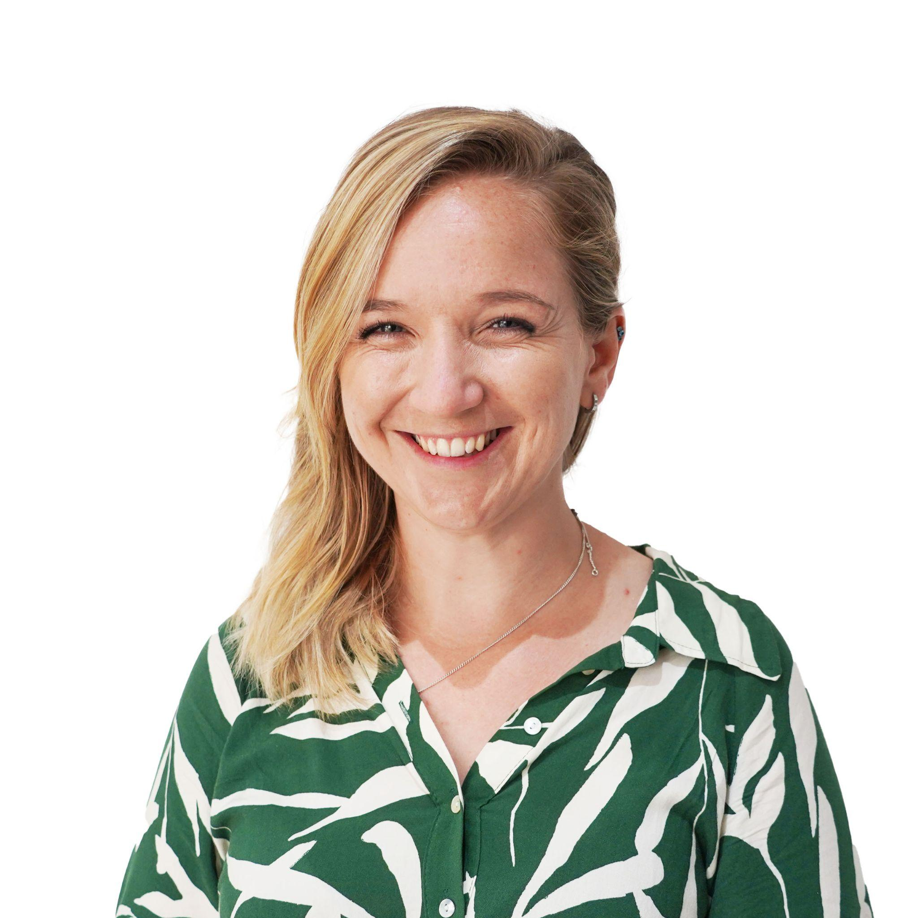
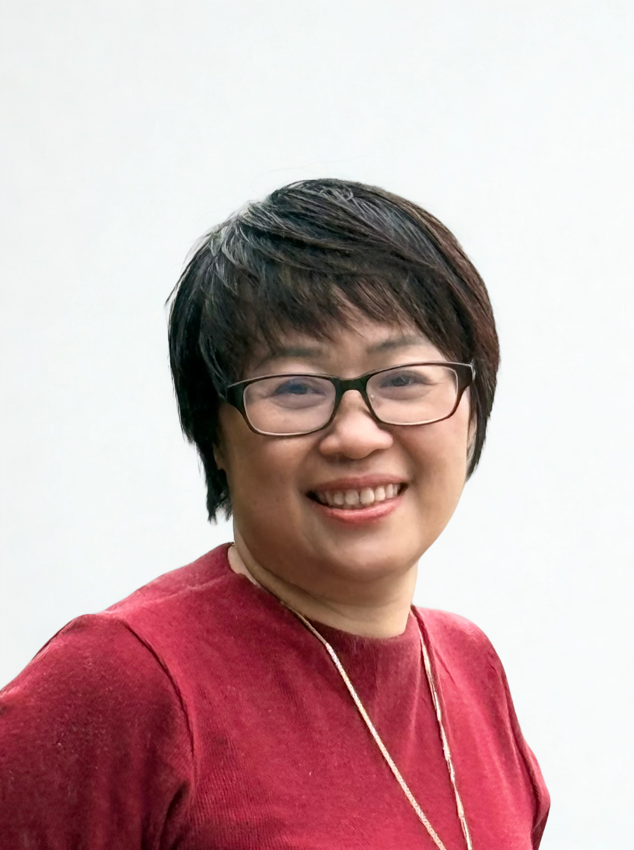


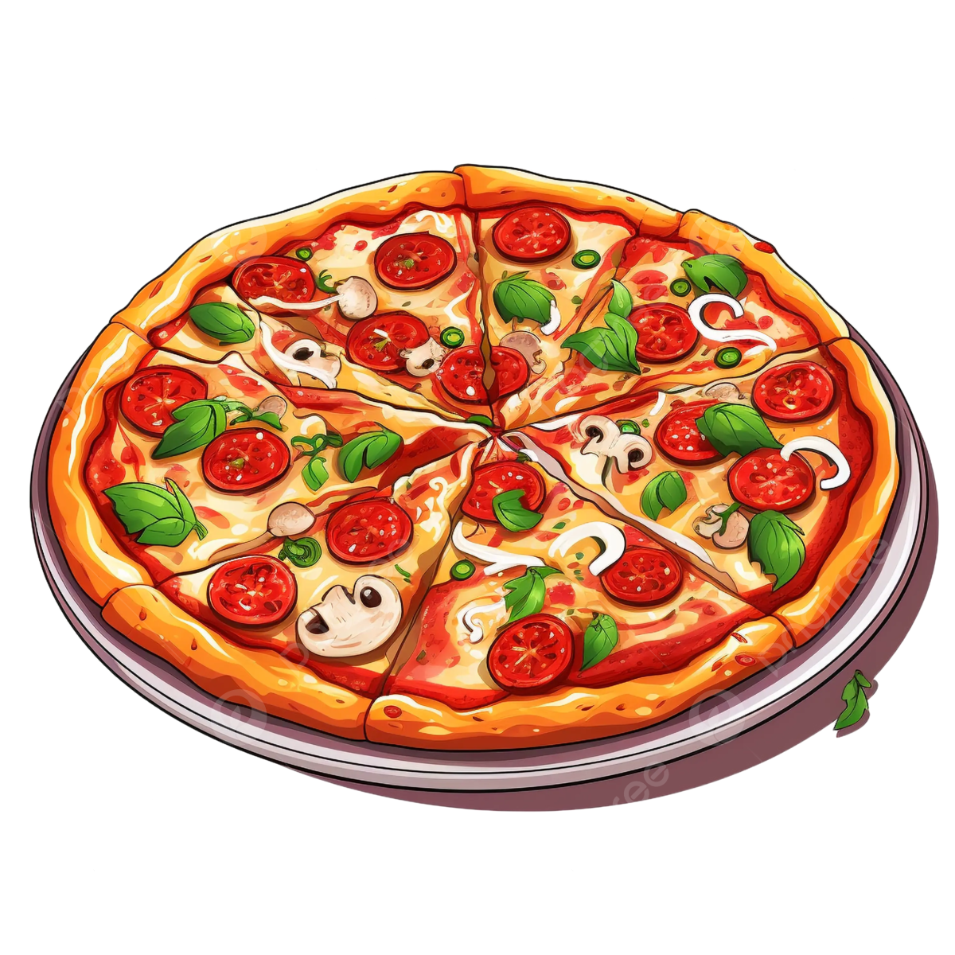



Who are we?
Ms Uyen
Ms Rhian

Slide 3
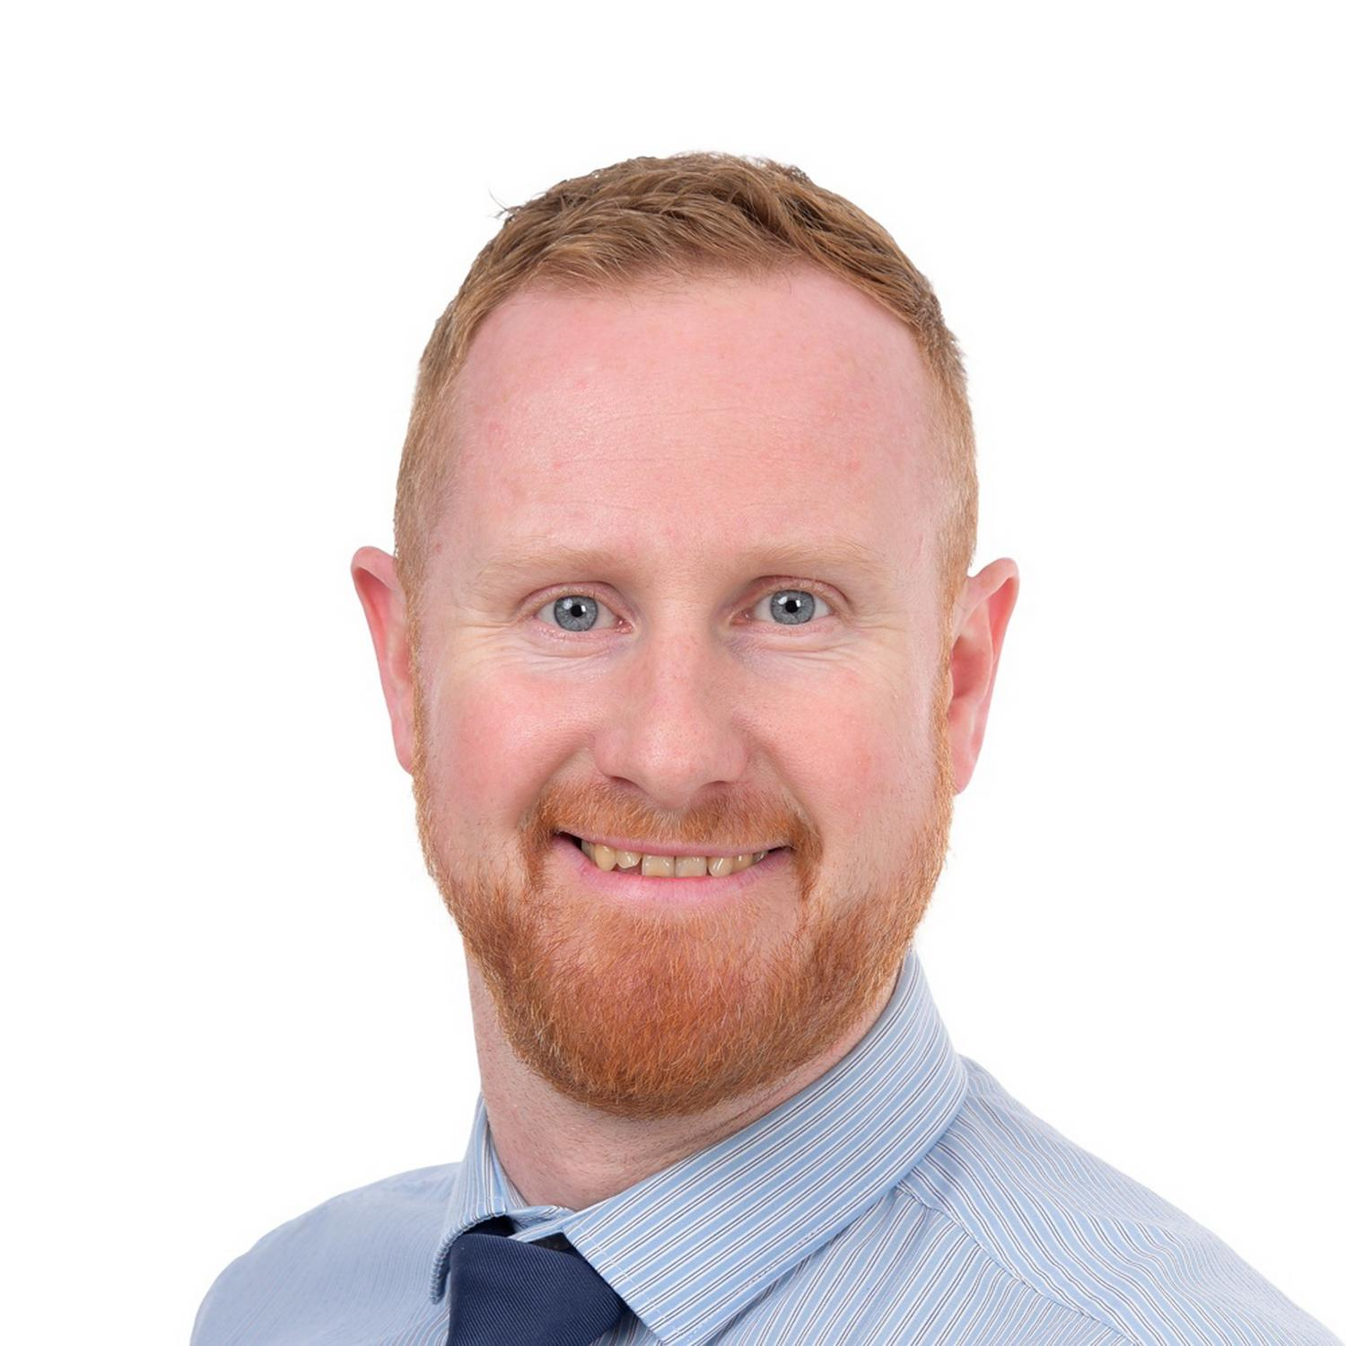
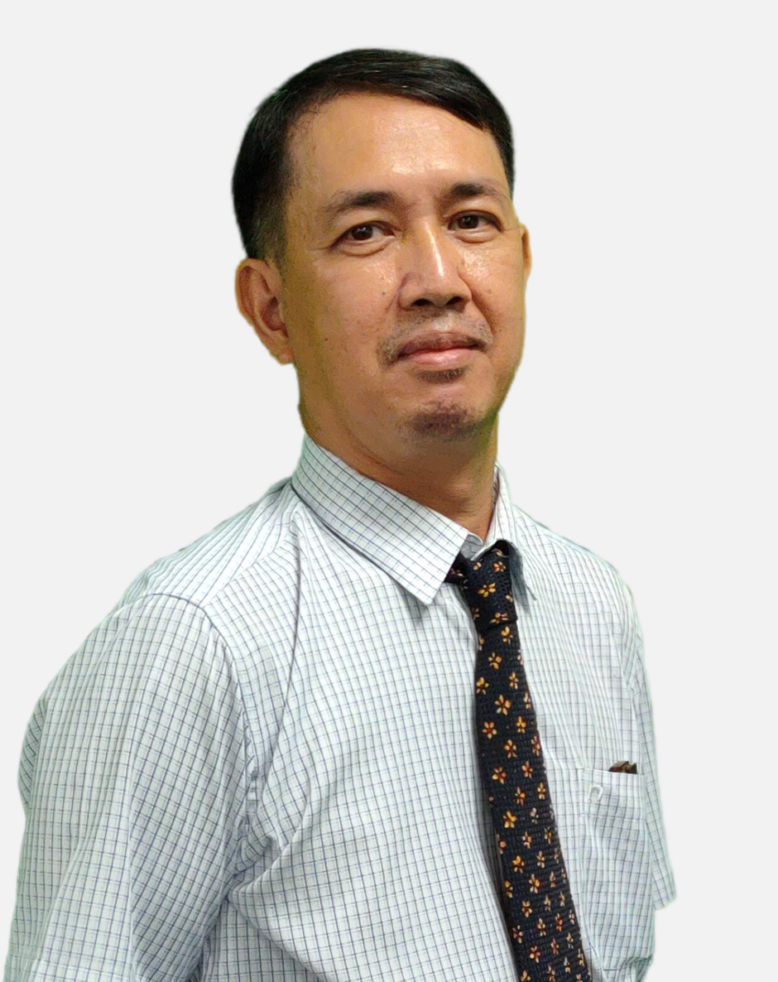
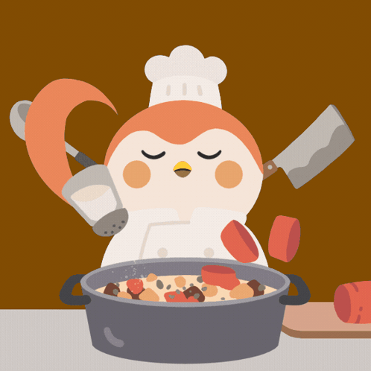




Who are we?
Mr Tue
Mr Anthony

Slide 4
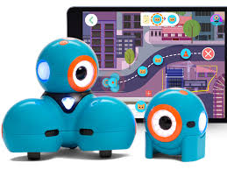
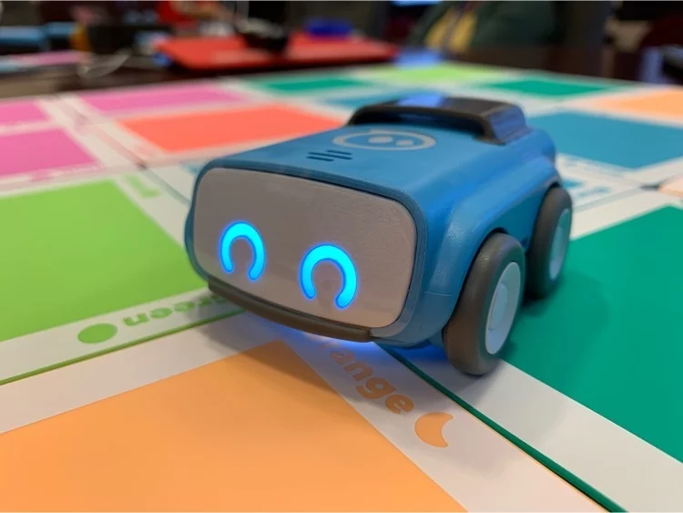
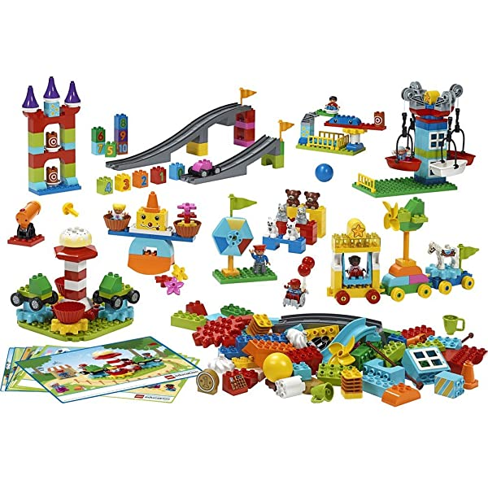

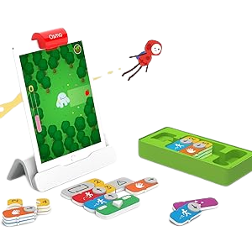
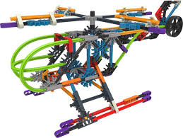
Exciting learning this year!

Slide 5

What do these look like in the DREAMS
Lab?

Slide 6
ICT
Expectations
Game
Hmm what should I do?

Slide 7
If…then…
…I should wait quietly against the wall.
…I should speak loudly to my friends.
If I am waiting outside for my teacher, then….
Notes:
Can stand up and go to the green wall or window or just point to the corner… depends on energy of class

Slide 8
If…then…
…. C3 B4 Me
(ask 3 friends for help before asking your ICT Teacher)
…. Go straight to
my teacher
for help
If I am stuck and I don’t know what to do next, then….

Slide 9
If…then…
…. I should run around the DREAMs Lab
…I should take a break and ask my teacher if I can drink water outside.
If I am in the yellow zone and feeling silly, then….
Notes:
Can stand up and go to the corner, nominate one person from each table to go to the corner or just point to the corner… depends on energy of class

Slide 10

What do we use this app for?
How do I login?

Slide 11
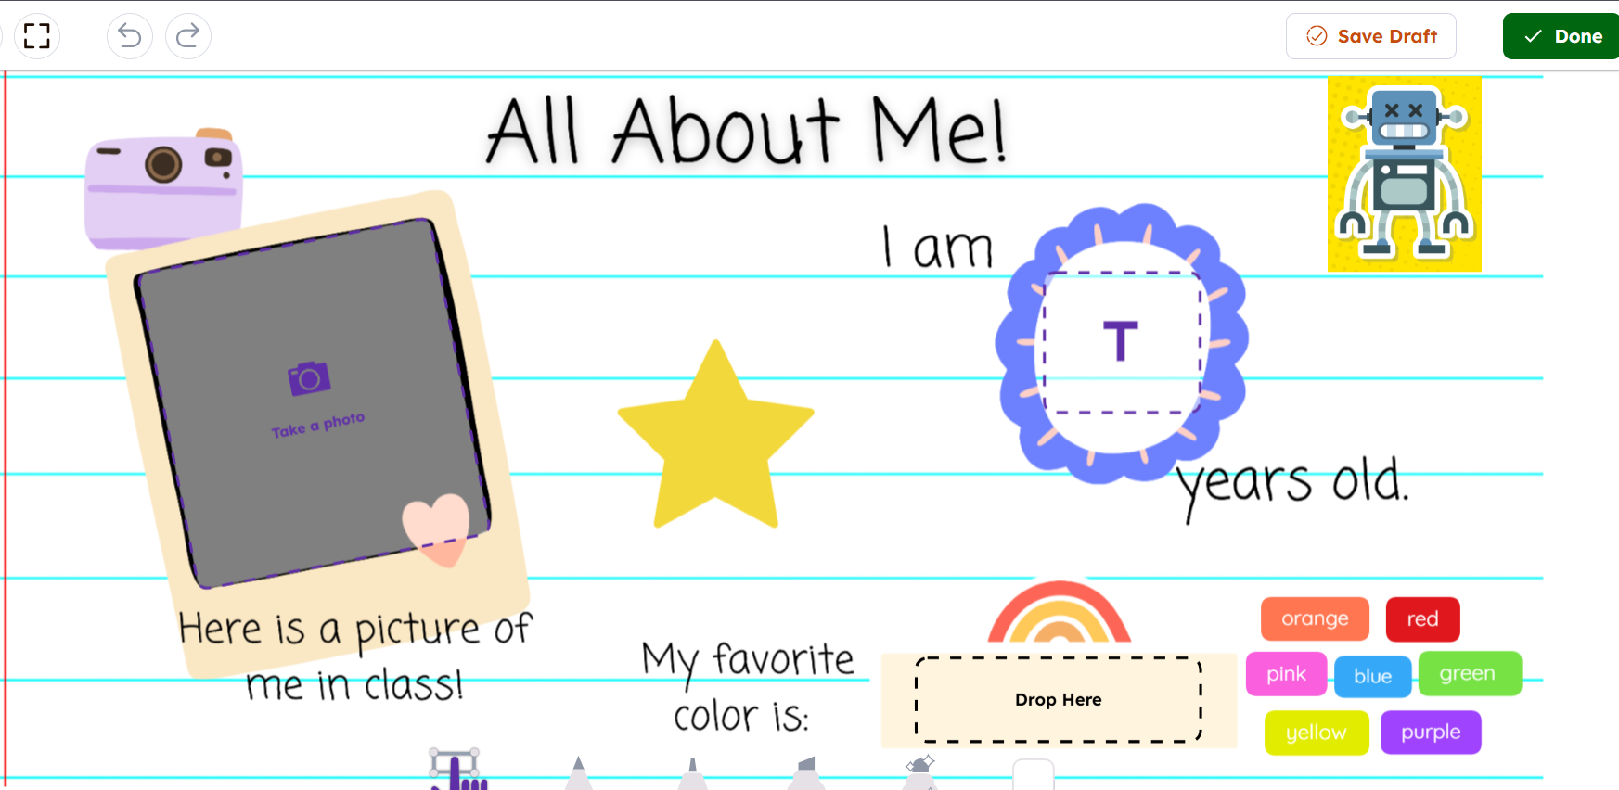
Year 1
Notes:
Seesaw

Slide 12
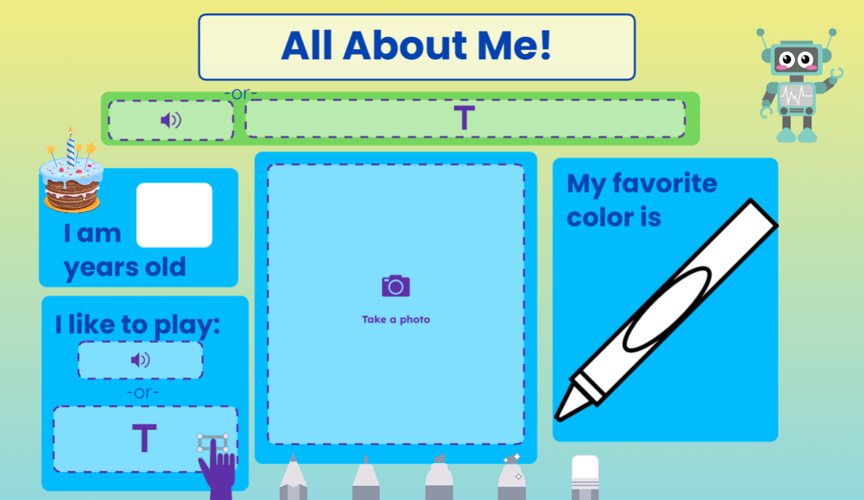
Year 2
Challenge:
Can you add an extra page to tell me more about yourself?

Slide 13
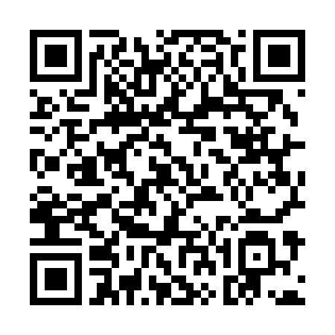
1H

Slide 14
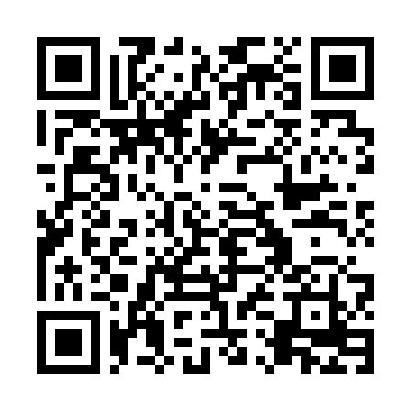
2N

Slide 15
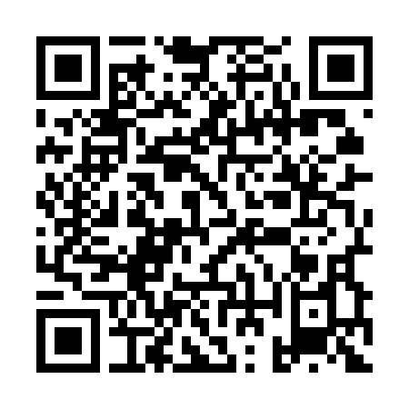
1C

Slide 16
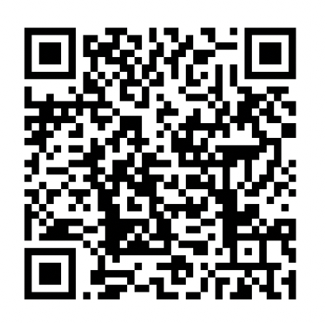
1i
Seesaw

Slide 17
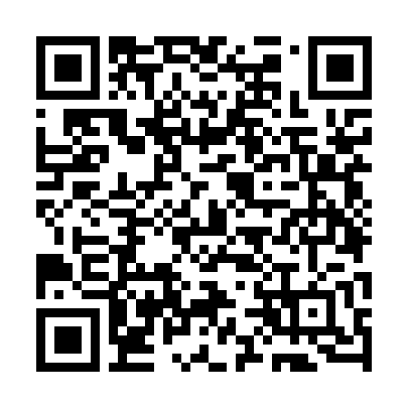
1B

Slide 18
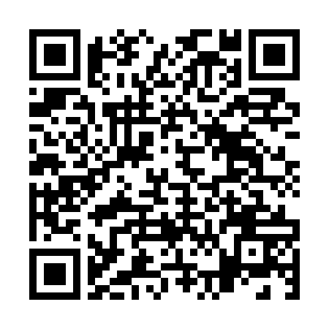
1N

Slide 19
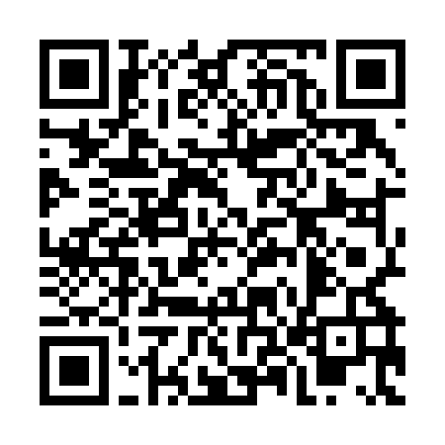
2H

Slide 20
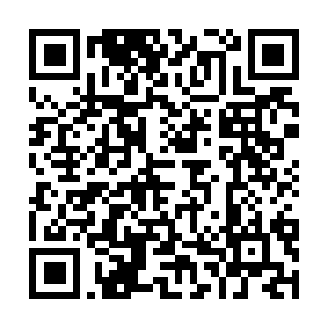
2C

Slide 21
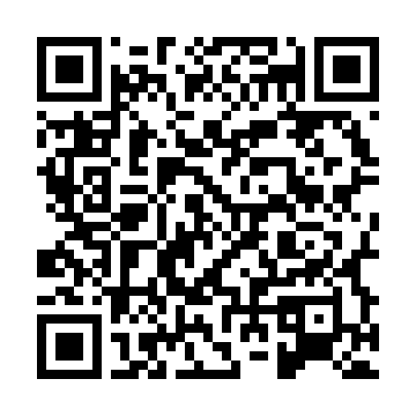
2B

Slide 22
Now, how do I log out?

Slide 23
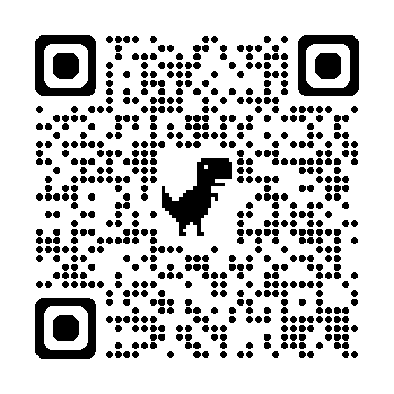
Mini Games Challenge

Slide 24
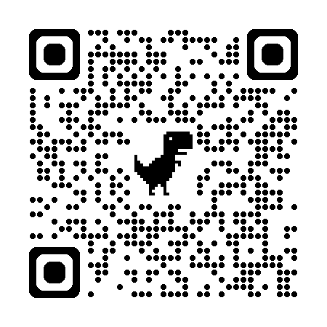
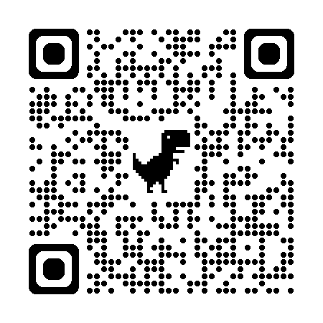
Word Wall Challenge Games

Slide 25
Welcome back to ICT!
2025
Lesson 2

Slide 26
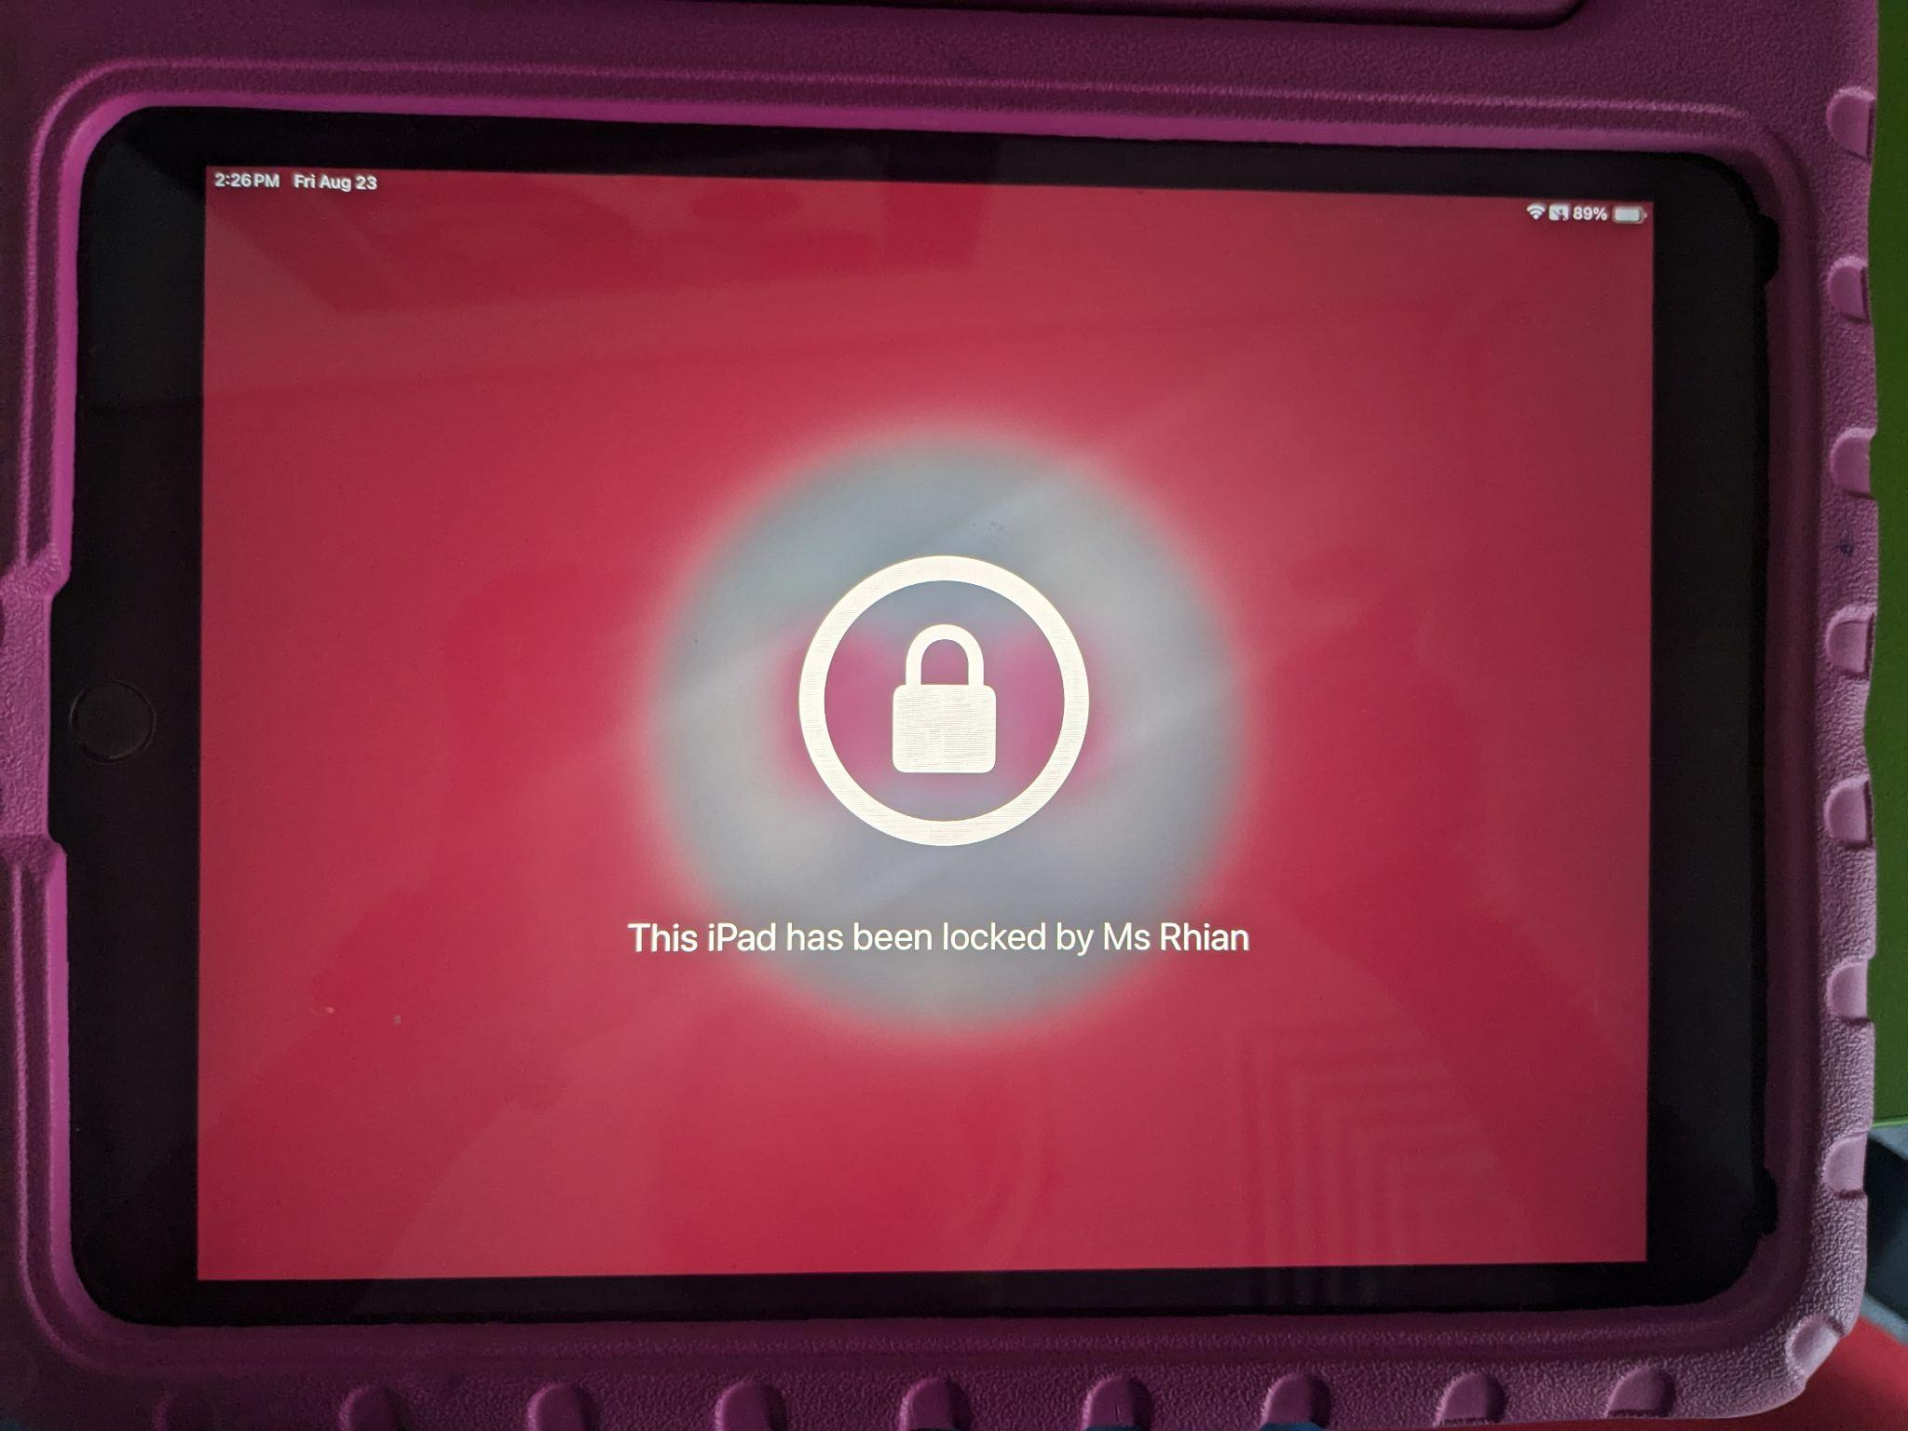

What should you do when you see this screen?

Slide 27
What do these look like in the DREAMS
Lab?

Slide 28
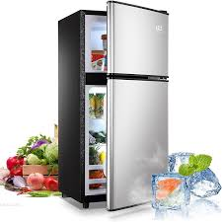
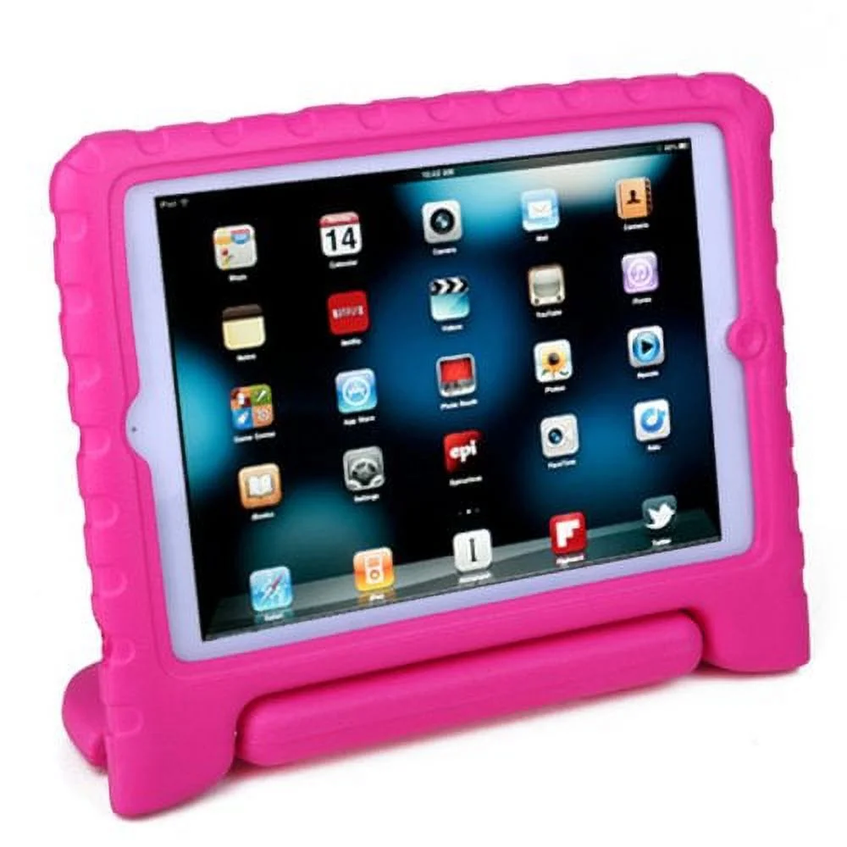
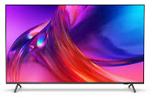
How many types of technology do you use every day?

Slide 29
What do we use this app for?
How do I login?

Slide 30
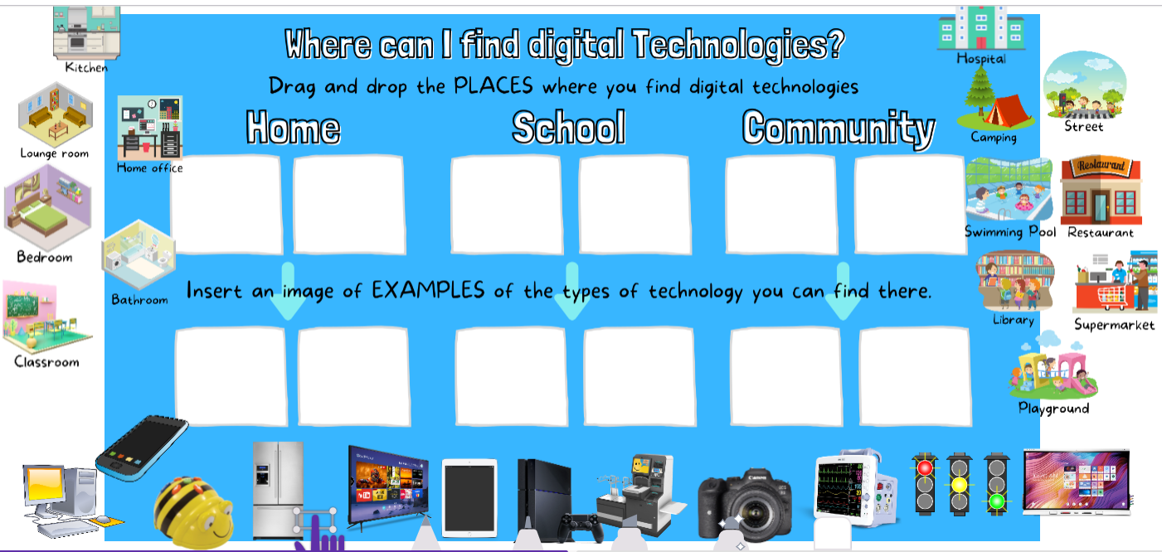
Y1 - Seesaw task
Notes:
Seesaw task

Slide 31
Word Wall Challenge Games

